Slide 1


Predicting MOLECULAR PROPERTIES
ALY6020: Predictive Analytics
CRN: 80807
Shivani Grover
&
Anish Nitin Somaiah
Instructor: Dr. Marco Montes De Oca
ALY 6020 PREDICTIVE ANALYTICS
Crn: 80807
Shivani GROVER
&
ANISH NITIN SOMAIAH
INSTRUCTOR : Dr. MARCO montes de oca

Slide 2
TABLE OF CONTENTS
Introduction
Project Objective and Methodology
About the dataset
Data Preparation
Data Exploration
Modelling & Accuracy Evaluation
Final Predictions

Slide 3
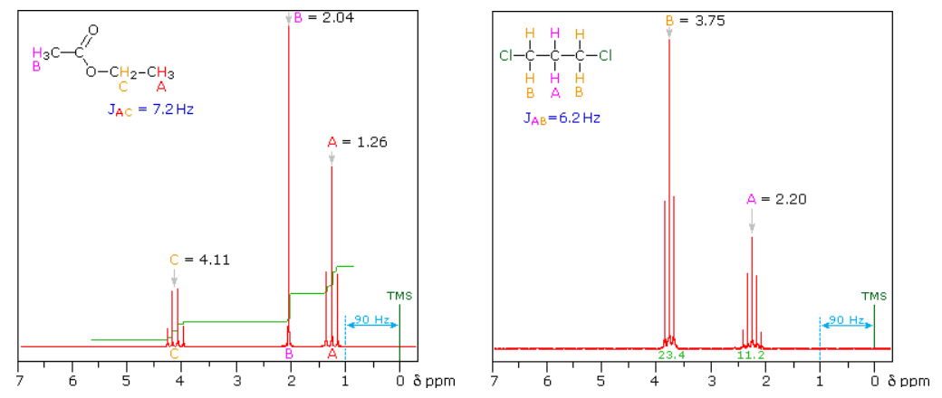
Introduction
Image 1
This dataset has been hosted by CHAMPS (Chemistry And Mathematics in Phase Space) at the University of Bristol, Cardiff University, Imperial College and the University of Leeds
This challenge aims to predict interactions between atoms. Imaging technologies like MRI enable us to see and understand the molecular composition of tissues.
NMR- Nuclear Magnetic Resonance Spectroscopy is an analytical tool used to determine the structure of organic compounds.

Slide 4
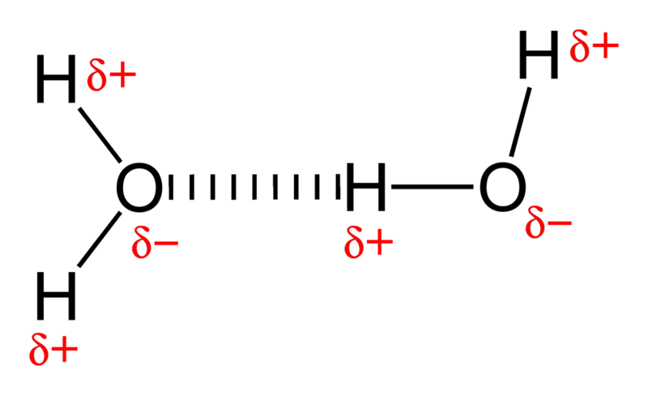
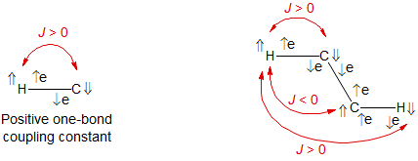
Coupling- atomic interaction
Image 2
[1]There are two distinct types of magnetic interaction (coupling) between nuclei (A and X) with a non-zero spin - the direct interaction (dipole-dipole coupling: D) and the indirect or scalar coupling (spin-spin splitting: J).
[1]The scalar coupling J is a through-bond interaction, in which the spin of one nucleus perturbs (polarizes) the spins of the intervening electrons, and the energy levels of neighboring magnetic nuclei are in turn perturbed by the polarized electrons. The J coupling (always reported in Hz) is field-independent
[1]Coupling constants can be either positive or negative, defined as follows: coupling constants are positive if the energy of A is lower when X has the opposite spin as A (αβ or βα), and negative if the energy of A is lower when X has the same spin as A (αα or ββ).
Image 3
Notes:
The direct interaction is about 1000 times as large as the scalar coupling (e.g. at 2 Å distance H-H dipolar coupling is ca 30,000 Hz). These direct couplings make the observation of high-resolution NMR spectra in solids and very viscous liquids difficult, and make NMR spectra in liquid crystals (where molecules are partially oriented, and the dipolar coupling is only partially averaged) very complex.
The scalar coupling J is a through-bond interaction, in which the spin of one nucleus perturbs (polarizes) the spins of the intervening electrons, and the energy levels of neighboring magnetic nuclei are in turn perturbed by the polarized electrons. This leads to a lowering of the energy of the neighboring nucleus when the perturbing nucleus has one spin, and a raising of the energy when it has the other spin. The J coupling (always reported in Hz) is field-independent

Slide 5
PROJECT OBJECTIVE AND METHODOLOGY
The objective of our project is to “Predict the Molecular Property” i.e. interaction between atoms in a molecule (scalar coupling constant) for every molecule in the test dataset by training a regression machine learning model over the given training data set.
Steps involved in the project include:
Data Preparation.
Correlation analysis to identify dependencies for the target variable.
Exploratory data analytics for dependent variables.
Modelling using regression techniques and evaluating accuracy of models.
Final prediction using the optimal model.

Slide 6
ABOUT THE DATASET
The dataset is obtained from one of the active Kaggle competitions “ Predicting Molecular Properties” hosted by CHAMPS (CHemistry And Mathematics in Phase Space) retrieved from https://www.kaggle.com/c/champs-scalar-coupling/data .
The following spreadsheets were used in our model and are as follows:
train.csv: this is the training data file with close to 4 million rows comprising of the molecule name, atom indices that form the pair, joint type of atoms in the molecule and their respective scalar coupling constants.
test.csv: this is the test file similar to that of the training file with close to 2 million row of different molecule names for which the scalar coupling constant is to be predicted.
structures.csv: this is the file that gives positional data of different atoms in a particular molecule by its x,y and z coordinates.
dipole_moments.csv: this is the file that gives X,Y and Z components of the dipole moments for each molecule.
mulliken_charges.csv: this is the file that gives the respective mulliken charge of each atom in a molecule.
potential_energy.csv: this is the file that gives the potential energy of each molecule.

Slide 7
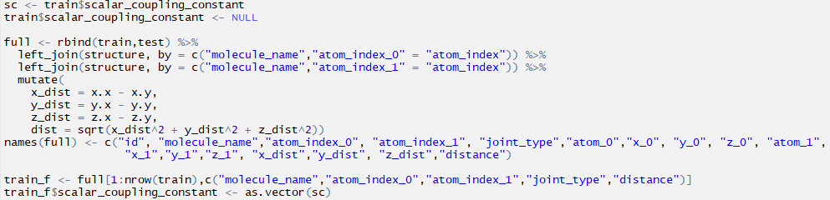
DATA PREPARATION
Theoretically, the scalar coupling constant depends upon the distance between atoms in the molecule.
But given dataset has only coordinates of atoms and no distance values. Hence distances are first calculated using the given x,y and z coordinates by formula
The R code for the data preparation is as follows:

Slide 8
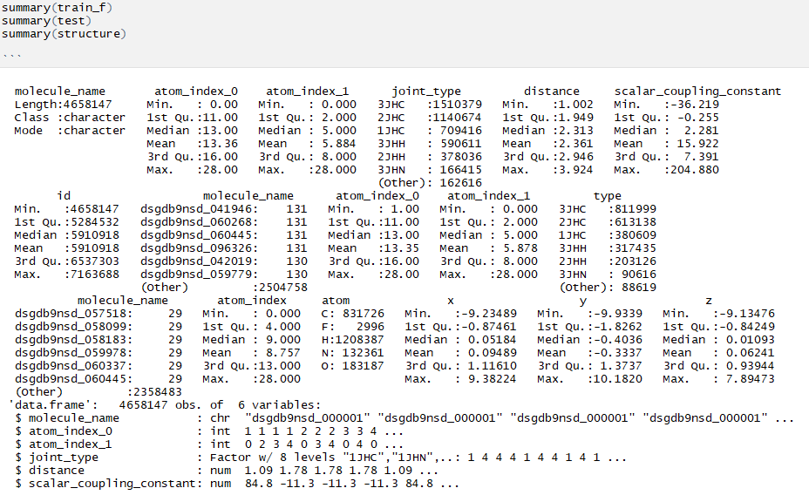
EXPLORATORY DATA ANALYTICS

Slide 9
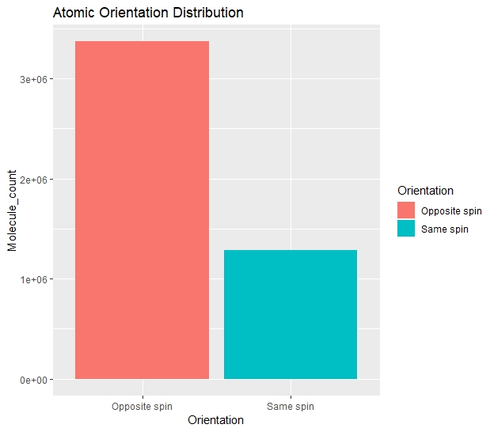
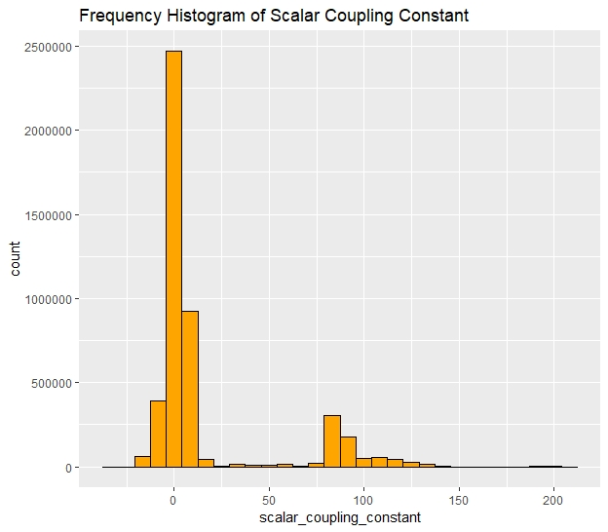
EXPLORATORY DATA ANALYSIS - CONTD

Slide 10
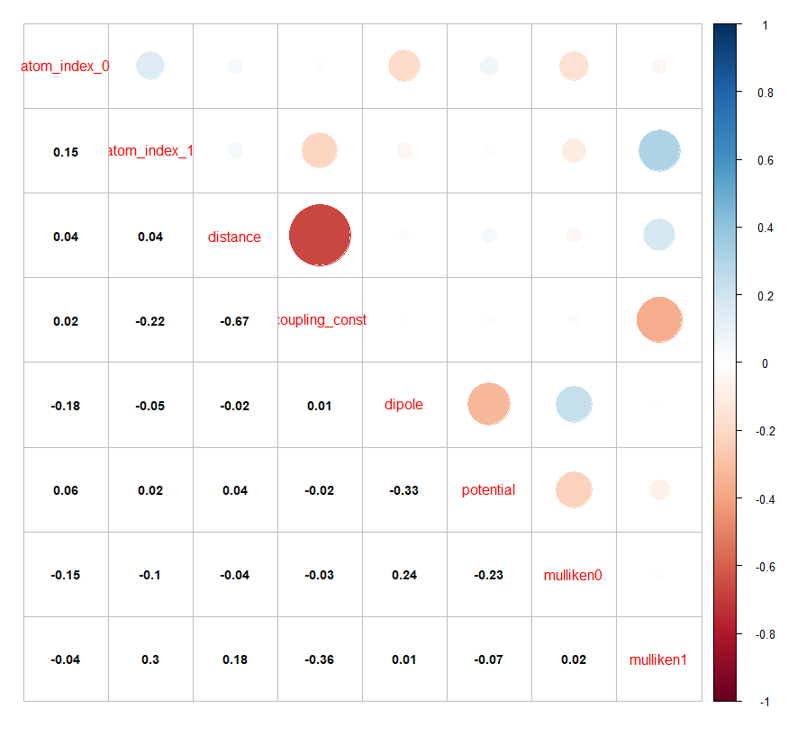
CORRELATION ANALYSIS
By theory and as per given data sets we observe that coupling constants depend upon distance between atoms in a molecule.
Since the distance factor is determined with the type of bond existing between the two atoms.
The other variables such as mulliken charge, potential energy, dipole moments do not have significant correlation.

Slide 11
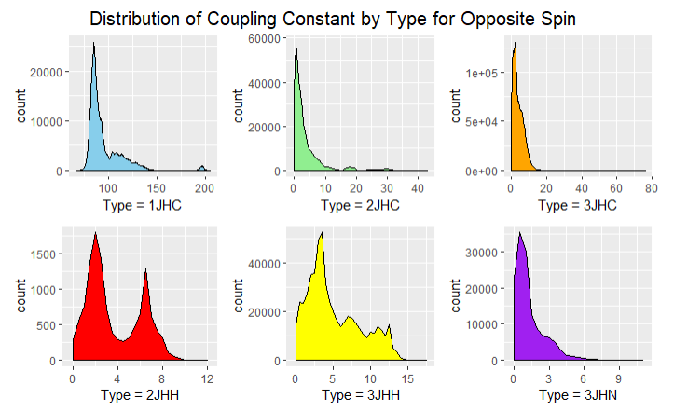
EXPLORATORY DATA ANALYSIS - CONTD

Slide 12
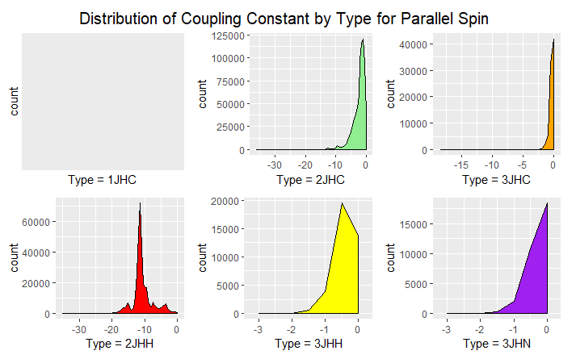
EXPLORATORY DATA ANALYSIS - CONTD

Slide 13
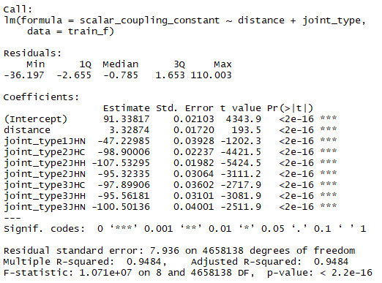
MODEL 1 : Linear Regression
Linear dependence of the response variable – scalar coupling constant on input variables – joint type and distance.

Slide 14
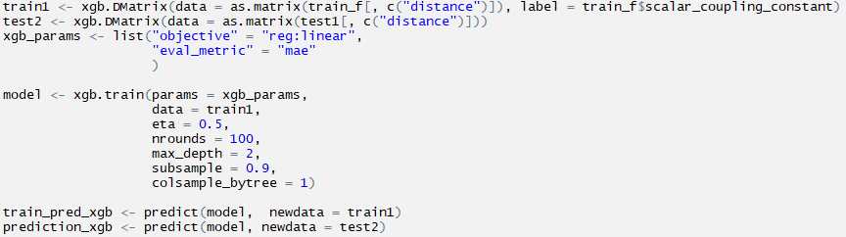
Model 2 – Gradient Boosting
Gradient boosting is a machine learning technique for regression and classification problems, which produces a prediction model in the form of an ensemble of weak prediction models, typically decision trees. It builds the model in a stage-wise fashion like other boosting methods do, and it generalizes them by allowing optimization of an arbitrary differentiable loss function.

Slide 15
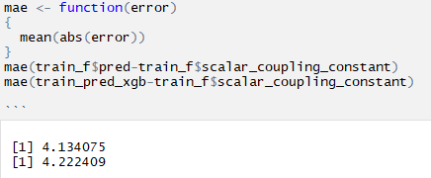
Model accuracy evaluation

Slide 16

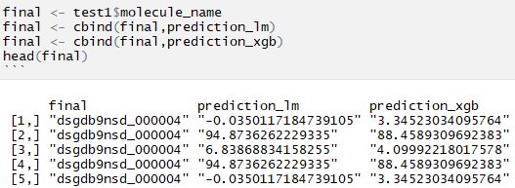
Predictions obtained using optimum model

Slide 17
REFERENCES
[1] Hans J. Reich (2017), Spin-Spin Splitting: J-Coupling, Retrieved from https://www.chem.wisc.edu/areas/reich/nmr/Notes-05-HMR-v26-part2.pdf
Image 1 Source : Nuclear Magnetic Resonance Spectroscopy, Retrieved from https://www2.chemistry.msu.edu/faculty/reusch/VirtTxtJml/Spectrpy/nmr/nmr1.htm
Image 2 Source : (2010) Hydrogen Bonding in Water, Retrieved from https://chemstuff.co.uk/2010/10/02/water/800px-hydrogen-bonding-in-water-2d/
Image 3 Source : Hans J. Reich (2017), Spin-Spin Splitting: J-Coupling, Retrieved from https://www.chem.wisc.edu/areas/reich/nmr/Notes-05-HMR-v26-part2.pdf

Slide 18
QUESTIONS ?
THANK YOU

